Slide 1
Regular pattern formation in semiarid vegetation
Carmen IJsebaart
16-10-2015

Slide 2
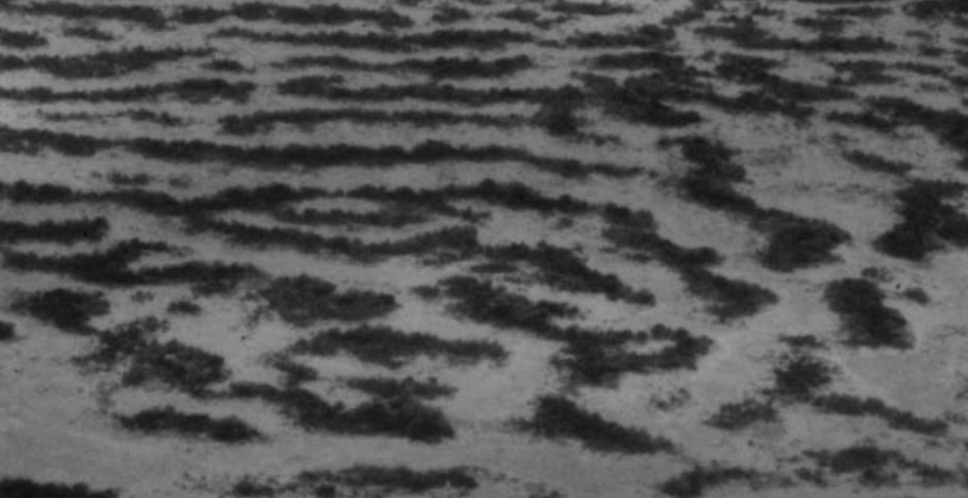
Introduction
Spatial patterns in Niamey, Niger, on a hillside

Slide 3
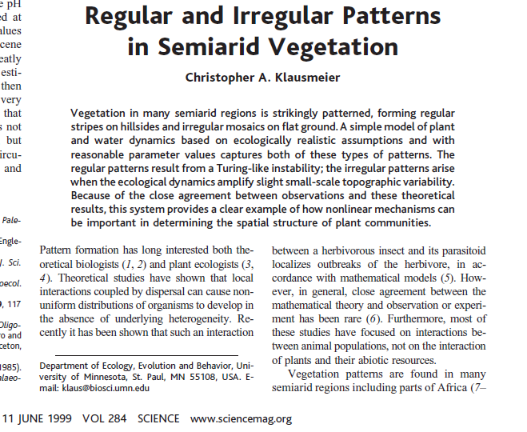
Introduction
Model: plants and water have an interaction:
Water flows over bare soil
Plants soak up water
Plant density increases
Decrease in bare soil

Slide 4
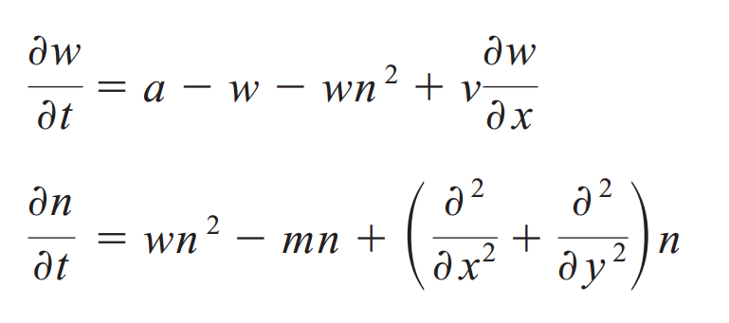
Model
System of differential equations:
Water (w) flows down the hill (in x direction)
Plants (n) grow in both x and y directions

Slide 5
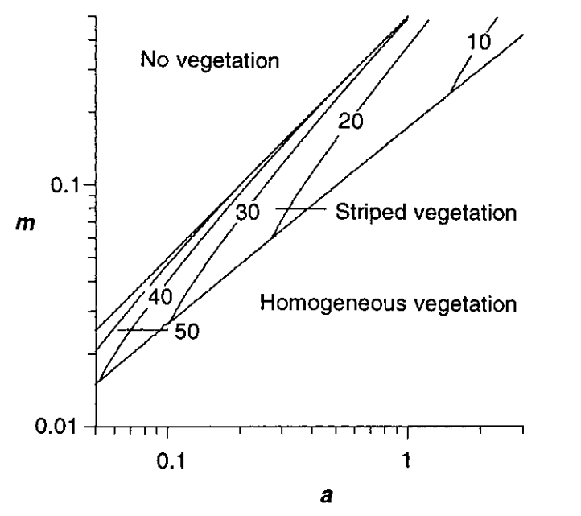
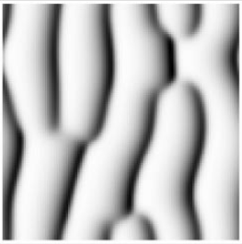
Model predictions
Sometimes bare soil
Sometimes plants everywhere
Sometimes striped vegetation
Fork

Slide 6
Research question
Can we reproduce the model accurately?
Which parameters matter?

Slide 7
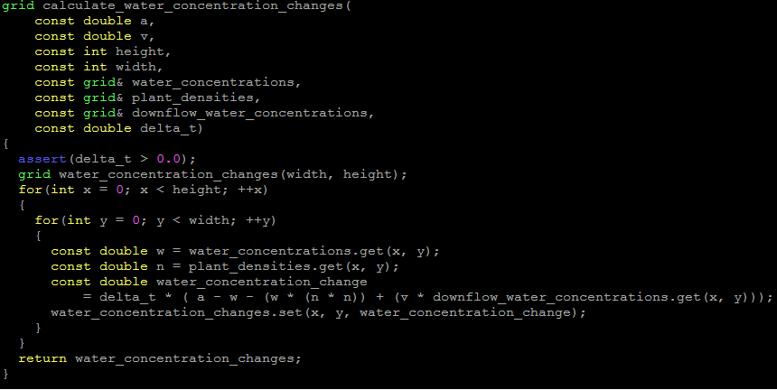
Approach
Write differential equations as functions
Visualize
Play with the parameters

Slide 8
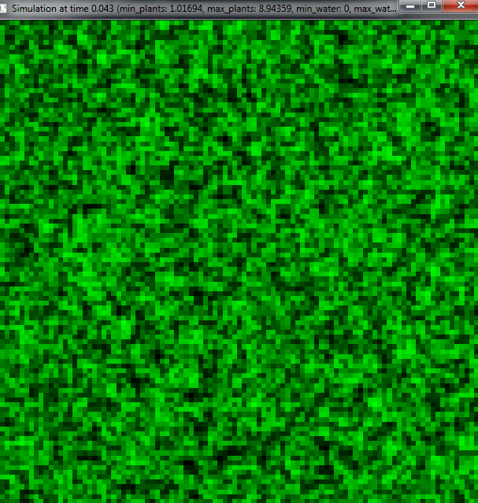
Results
Initialize with random plant densities
Do not visualize water, because it moves too fast

Slide 9
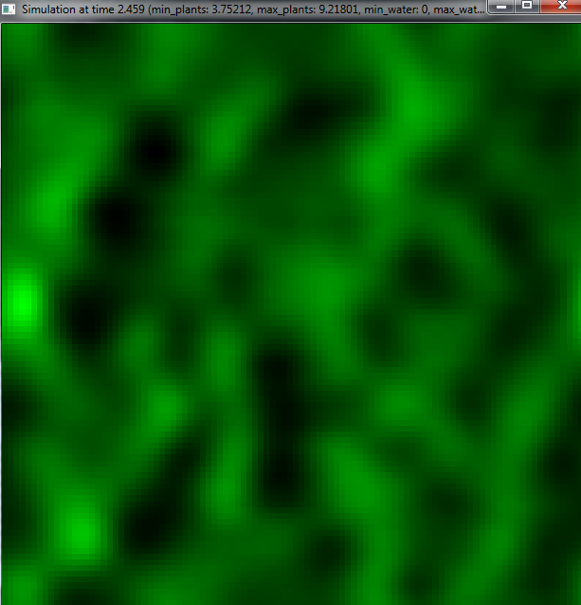
Results
Quickly goes to something smooth

Slide 10
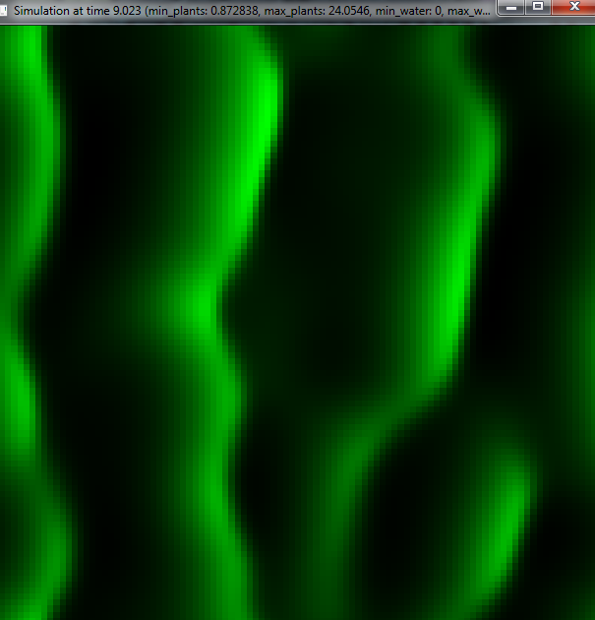
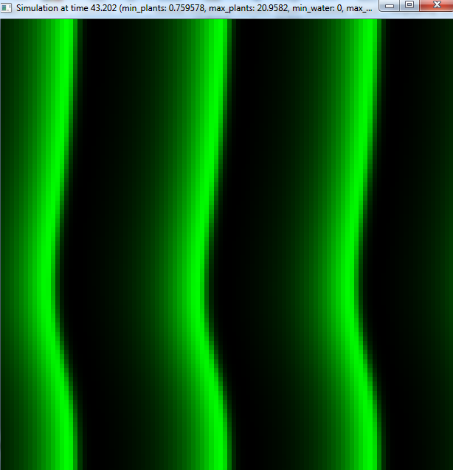
Results
Forks observed, as in the article

Slide 11
Results
Parameter settings used in the article gave different results in this simulation

Slide 12
Conclusions
Simulation gave qualitatively same results
dt matters a lot, set to 0.001 (program crashes otherwise, because plants grow to infinite density)

Slide 13
Other conclusions
Big difference between debug and release mode!
Visualization was a very handy tool to debug the code

Slide 14
Discussion
Spend a lot of time on the mathematical model
No time left for systematic comparison

Slide 15

Acknowledgements
2D visualization: Richel

Slide 16
Questions??

